Slide 1
Attacks on RSA cryptosystem

Slide 2
Potential attacks on RSA
Factorization
Chosen-ciphertext
Attacks on the encryption exponent
Coppersmith theorem attack
Broadcast attack
Attacks on the encryption exponent
Revealed decryption exponent attack
Low decryption exponent attack
Plaintext attack
Short message attack
Cyclic attack
Attacks on Implementation
Timing attack
Power attack

Slide 3
Factorization attack
The security of RSA is based on the idea that the modulus is so large that it is infeasible to factor it in a reasonable time. Some of the factorization algorithm are (Trial Division Method, Fermat Method, Pollard Rho Method, Efficient methods (Quadratic Sieve, Number Field Sieve)). **Will discuss Fermat Method and Pollard Rho Method in some other online class.**
To be secure, RSA presently requires that n should be more than 300 decimal digits (atleast 1024 bits).

Slide 4
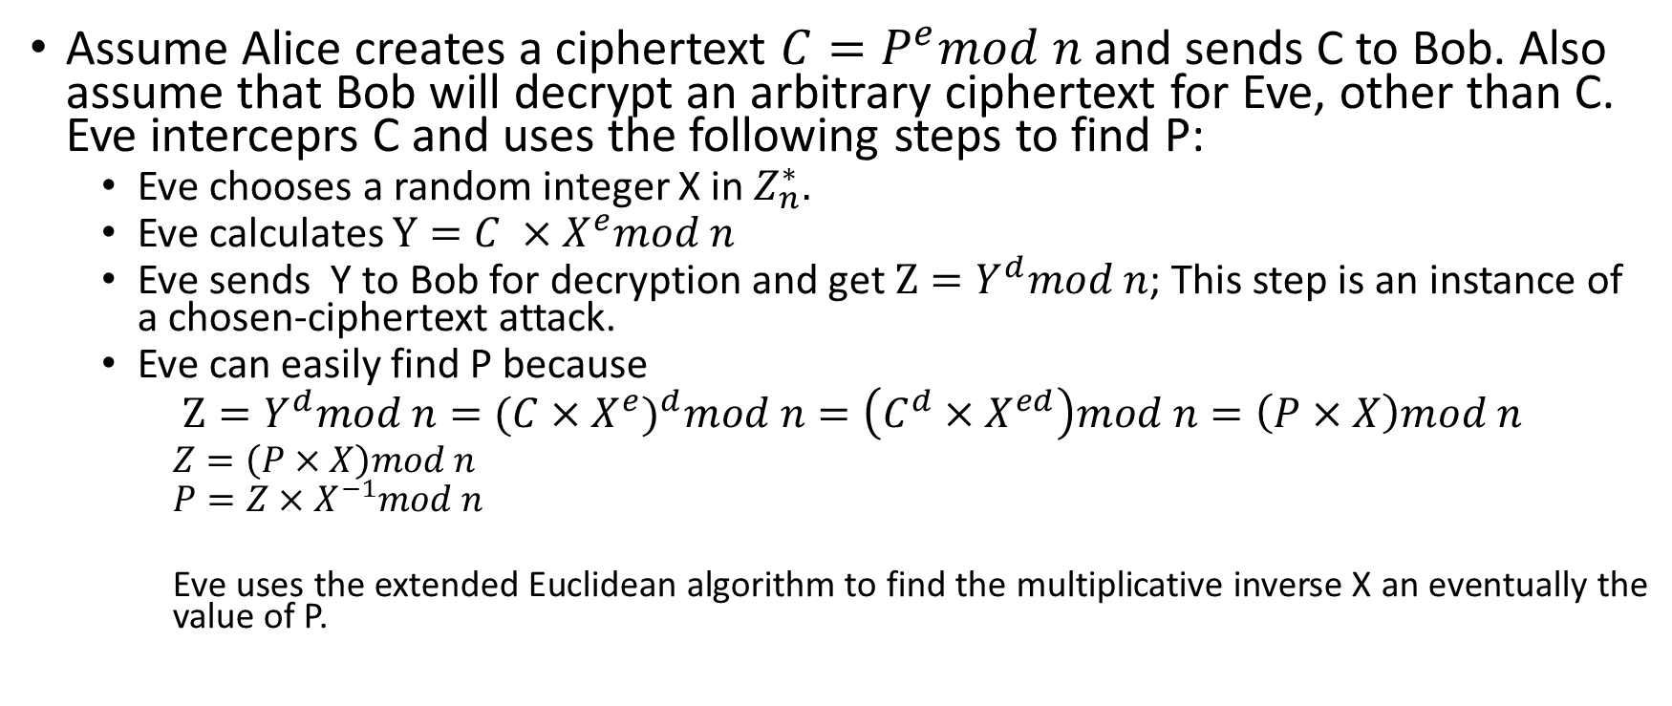
Chosen Ciphertext attack:
Assume Alice creates a ciphertext $C=P^{e}mod n$ and sends C to Bob. Also assume that Bob will decrypt an arbitrary ciphertext for Eve, other than C. Eve interceprs C and uses the following steps to find P:
Eve chooses a random integer X in $Z_{n}^{∗}.$
Eve calculates $Y={C ×X}^{e}mod n$
Eve sends Y to Bob for decryption and get $Z=Y^{d}mod n$; This step is an instance of a chosen-ciphertext attack.
Eve can easily find P because
$Z=Y^{d}mod n=({C×X^{e})}^{d}mod n=\left(C^{d}×X^{ed}\right)mod n=\left(P×X\right)mod n$
$Z=\left(P×X\right)mod n$
$$P=Z×X^{−1}mod n$$
Eve uses the extended Euclidean algorithm to find the multiplicative inverse X an eventually the value of P.

Slide 5
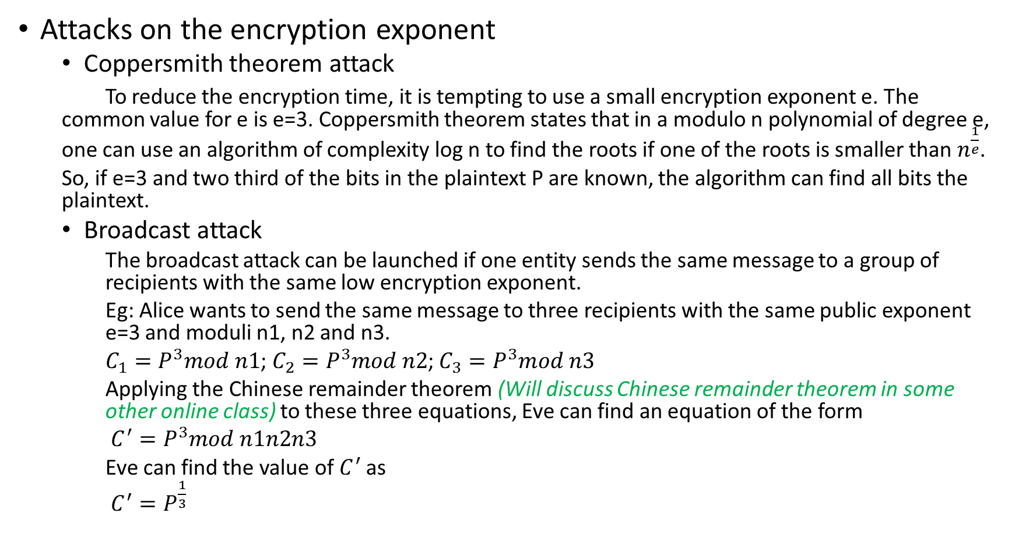
Attacks on the encryption exponent
Coppersmith theorem attack
To reduce the encryption time, it is tempting to use a small encryption exponent e. The common value for e is e=3. Coppersmith theorem states that in a modulo n polynomial of degree e, one can use an algorithm of complexity log n to find the roots if one of the roots is smaller than $n^{\frac{1}{e}}$.
So, if e=3 and two third of the bits in the plaintext P are known, the algorithm can find all bits the plaintext.
Broadcast attack
The broadcast attack can be launched if one entity sends the same message to a group of recipients with the same low encryption exponent.
Eg: Alice wants to send the same message to three recipients with the same public exponent e=3 and moduli n1, n2 and n3.
$C_{1}=P^{3}mod n1$; $C_{2}=P^{3}mod n2$; $C_{3}=P^{3}mod n3$
Applying the Chinese remainder theorem (Will discuss Chinese remainder theorem in some other online class) to these three equations, Eve can find an equation of the form
$C^{′}=P^{3}mod n1n2n3$
Eve can find the value of $C^{′}$ as
$C^{′}=P^{\frac{1}{3}}$

Slide 6
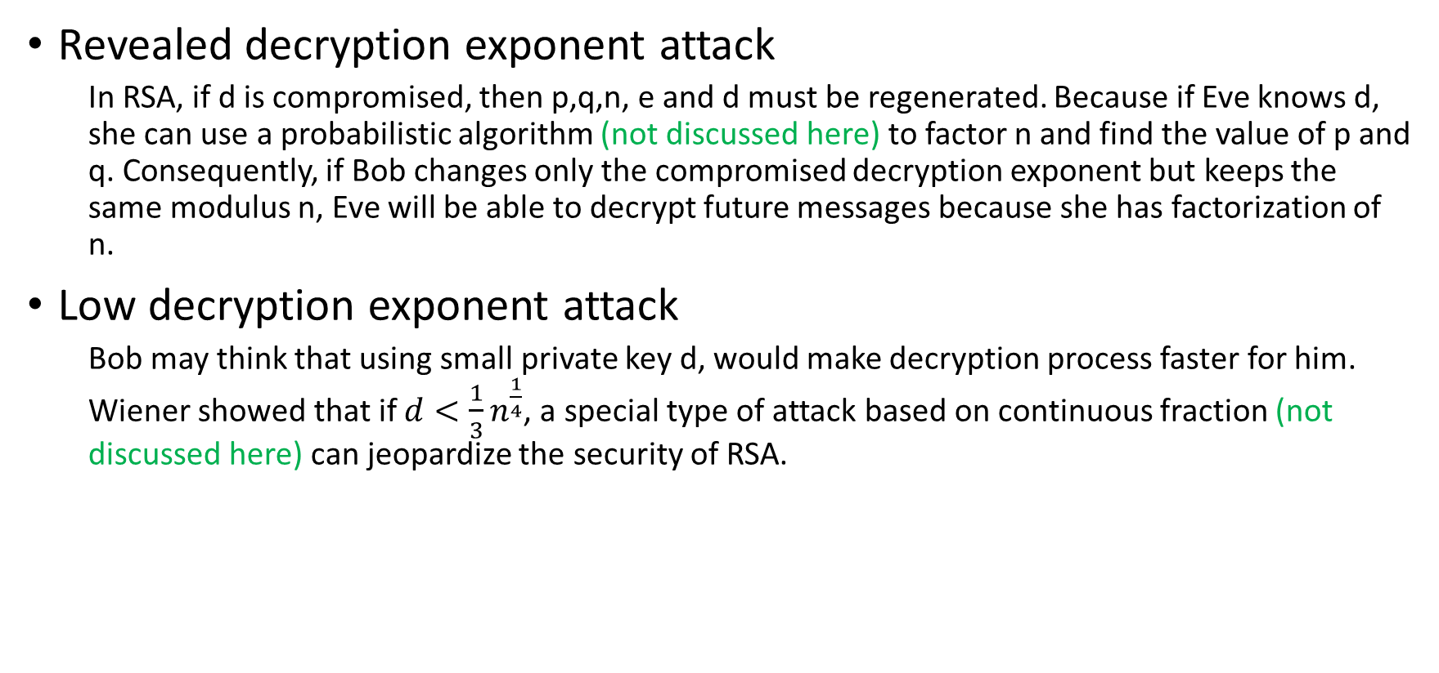
Attacks on the encryption exponent
Revealed decryption exponent attack
In RSA, if d is compromised, then p,q,n, e and d must be regenerated. Because if Eve knows d, she can use a probabilistic algorithm (not discussed here) to factor n and find the value of p and q. Consequently, if Bob changes only the compromised decryption exponent but keeps the same modulus n, Eve will be able to decrypt future messages because she has factorization of n.
Low decryption exponent attack
Bob may think that using small private key d, would make decryption process faster for him. Wiener showed that if $d<\frac{1}{3}n^{\frac{1}{4}}$, a special type of attack based on continuous fraction (not discussed here) can jeopardize the security of RSA.

Slide 7
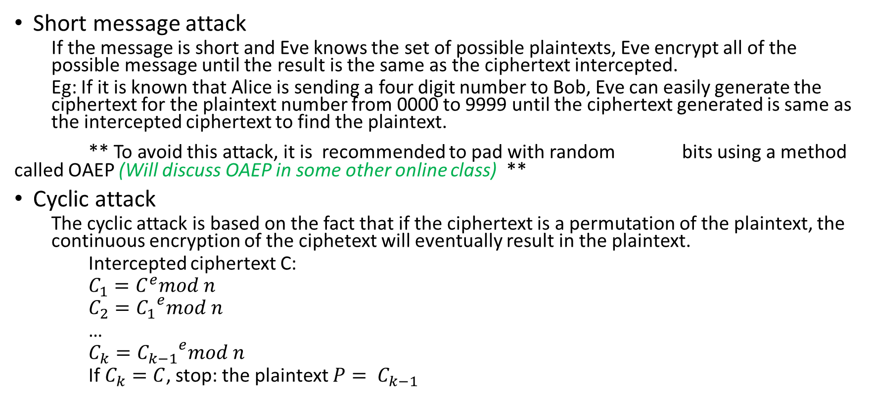
Plaintext attack
Short message attack
If the message is short and Eve knows the set of possible plaintexts, Eve encrypt all of the possible message until the result is the same as the ciphertext intercepted.
Eg: If it is known that Alice is sending a four digit number to Bob, Eve can easily generate the ciphertext for the plaintext number from 0000 to 9999 until the ciphertext generated is same as the intercepted ciphertext to find the plaintext.
** To avoid this attack, it is recommended to pad with random bits using a method called OAEP (Will discuss OAEP in some other online class) **
Cyclic attack
The cyclic attack is based on the fact that if the ciphertext is a permutation of the plaintext, the continuous encryption of the ciphetext will eventually result in the plaintext.
Intercepted ciphertext C:
$C_{1}=C^{e}mod n$
$C_{2}={C_{1}}^{e}mod n$
…
$C_{k}={C_{k−1}}^{e}mod n$
If $C_{k}=C$, stop: the plaintext $P= C_{k−1}$

Slide 8
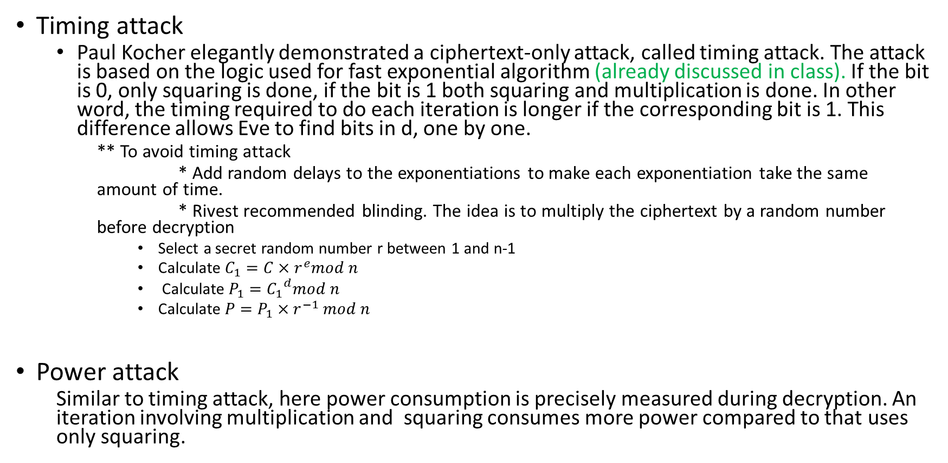
Attacks on Implementation
Timing attack
Paul Kocher elegantly demonstrated a ciphertext-only attack, called timing attack. The attack is based on the logic used for fast exponential algorithm (already discussed in class). If the bit is 0, only squaring is done, if the bit is 1 both squaring and multiplication is done. In other word, the timing required to do each iteration is longer if the corresponding bit is 1. This difference allows Eve to find bits in d, one by one.
** To avoid timing attack
* Add random delays to the exponentiations to make each exponentiation take the same amount of time.
* Rivest recommended blinding. The idea is to multiply the ciphertext by a random number before decryption
Select a secret random number r between 1 and n-1
Calculate $C_{1}={C×r}^{e}mod n$
Calculate $P_{1}={C_{1}}^{d}mod n$
Calculate $P=P_{1}×r^{−1} mod n$
Power attack
Similar to timing attack, here power consumption is precisely measured during decryption. An iteration involving multiplication and squaring consumes more power compared to that uses only squaring.

